Slide 1
Simulated annealing

Slide 2
Problem: Iterative Improvement stops at Local
minima, which can be very “poor”.
Strategies are required to prevent the search from getting trapped in local minima and to escape from them.

Slide 3
Three basic ideas
1) Accept up-hill moves
i.e., the search moves toward a solution with a worse objective function value
Intuition: climb the hills and go downward in another direction
2) Change neighborhood structure during the search
Intuition: different neighborhoods generate different search space topologies
3) Change the objective function so as to “fill-in” local minima
Intuition: modify the search space with the aim of making more “desirable” not yet explored areas

Slide 4
Simulated Annealing
Simulated Annealing exploits the first idea:
accept also up-hill moves.
Origins in statistical mechanics (Metropolis algorithm)
It allows moves resulting in solutions of worse quality than the current solution
The probability of doing such a move is decreased during the search.

Slide 5
Simulated Annealing
Simulated Annealing exploits the first idea:
accept also up-hill moves.
Origins in statistical mechanics (Metropolis algorithm)
It allows moves resulting in solutions of worse quality than the current solution
The probability of doing such a move is decreased during the search.

Slide 6
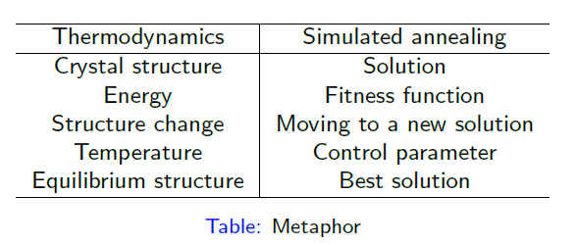

Slide 7
Simulated Annealing
Can be interpreted as a modified random descent in the space of solutions
Choose a random neighbor
Improving moves are always accepted
Deteriorating moves are accepted with a probability that depends on the amount of the deterioration and on the temperature (a parameter that decreases with time)
Can escape local optima

Slide 8
Move Acceptance in SA
We assume a minimization problem
Set Δ = Obj(random neighbor) – Obj(current solution)
If Δ < 0 → accept (we have an improving move)
Else accept if
If the move is not accepted: try another random neighbor

Slide 9
Convergence of simulated annealing

